Slide 1

Full Stack Development: FSD Semester –Even/Odd, Session 2024-25 Day-0

Slide 2
Full Stack Developer
Over 2 billion Websites
Need for enhanced customer experience
Approximately 4.54 billion active internet users
The Full Stack developer role is the No.1 position to be filled in 2020 according to 38% of hiring managers. This is closely followed by the role of a back-end developer.
Among one of the most in demand job profiles for B. Tech Graduates
Ability to work on both frond-end and back-end
Knowledge of a broad spectrum of technologies
Easy to learn
Provides a much wider understanding of the scope of the project
Creative flexibility
Handsome salary packages
The demand for full-stack developers will steadily increase in the market as new technologies emerge.

Slide 3


Full Stack Development
Front-End Development
Back-End Development
Database
Rest API
Web Application Architecture
Design Pattern
Version Control System

Slide 4
Full Stack Developer – Job Roles/Job Profiles
Front-End Developer – Front-end web development, also known as client-side development is the practice of producing HTML, CSS and JavaScript for a website or Web Application.
Back-End Developer – Back-end Development refers to the server-side development. It focuses on databases, scripting, website architecture.
Full Stack Developer – Full Stack Development requires proficiency in both front-end and back-end development.
User Experience designer – Designing interactions between system and user.
Software Developer/Engineer – A generalized profile usually it may refer to any of the above job requirement.
Web Designer – Web designer is the role of someone who formulates solutions to problems specific to the web environment based on the higher-level limitations of that environment.
DevOps engineer – Deploying the system to production servers, maintaining the system, creating and maintaining application development and production environments, and preparing for backup and recovery.

Slide 5




Back-End
Front-End
Database

Slide 6



Slide 7

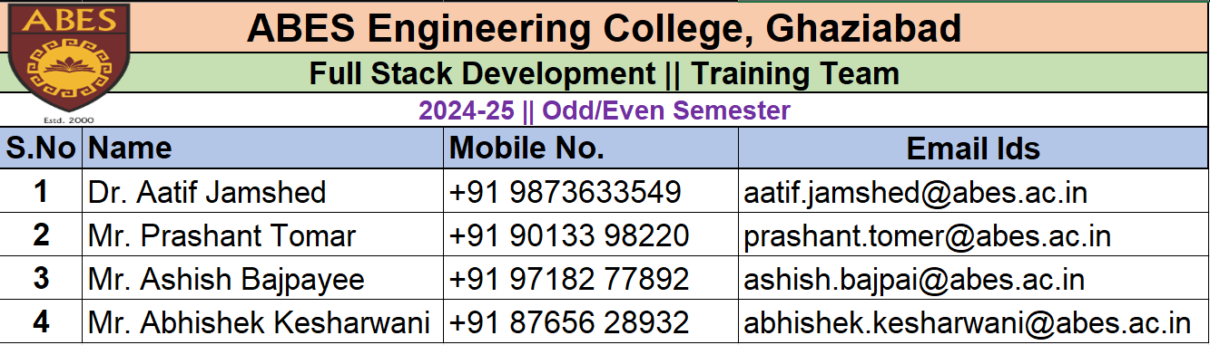
Training Team

Slide 8
Objectives
To equip students with the skills to create responsive, user-friendly web interfaces using HTML, CSS, and JavaScript frameworks like React.js.
To enable students to build robust server-side applications using Node.js and Express.js. They will learn to manage server operations, handle requests and responses, and integrate with databases.
To gain the ability to perform CRUD operations, model data, and connect the database with the application back-end.
To implement and manage API endpoints, handle different HTTP methods, and ensure secure data transmission.
To learn deployment strategies using cloud services and DevOps tools, ensuring their applications are production-ready.

Slide 9
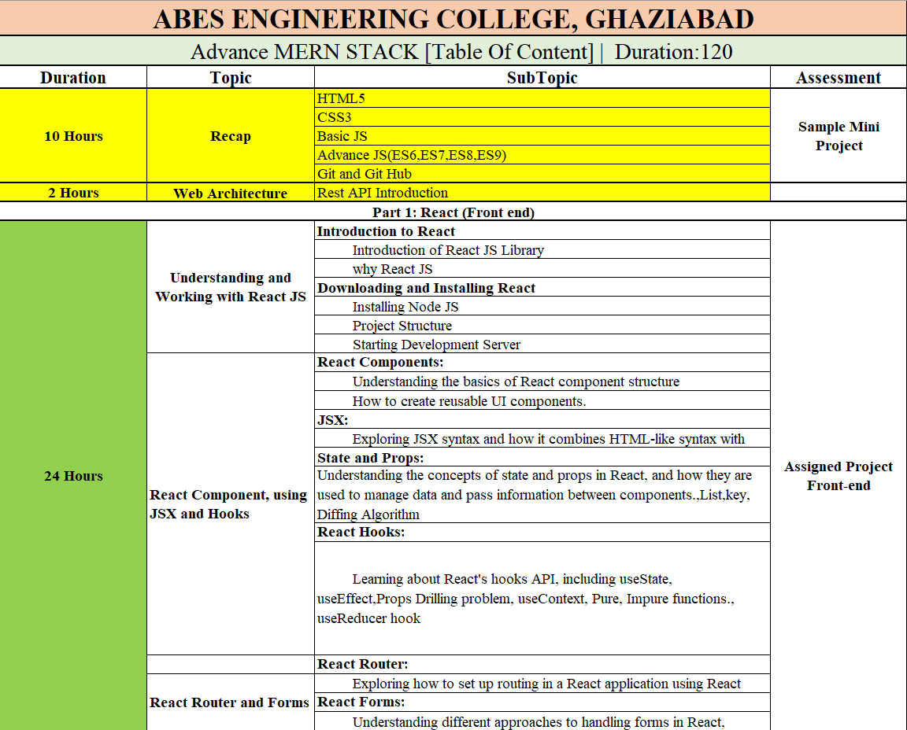
Syllabus

Slide 10
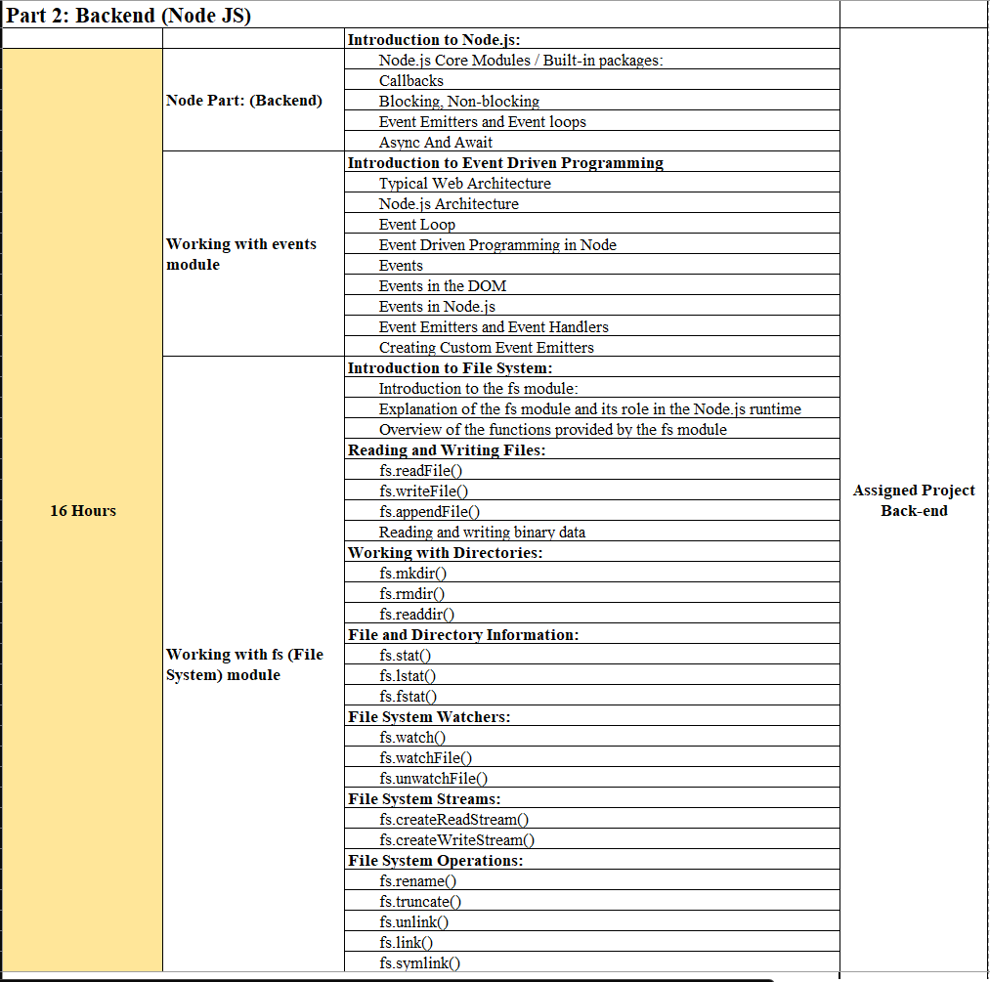
Syllabus

Slide 11
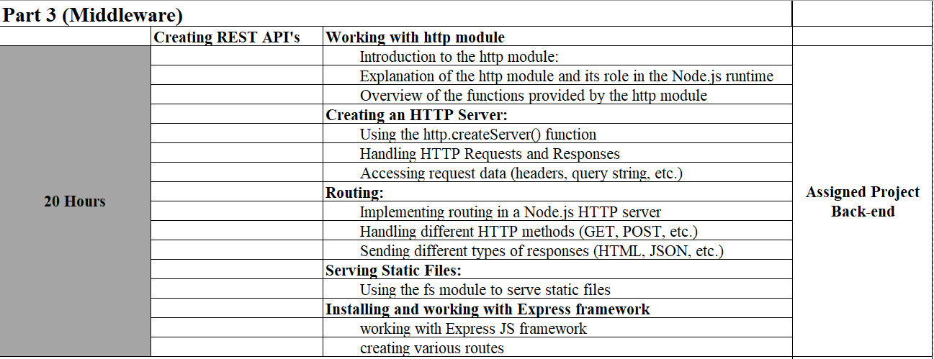
Syllabus

Slide 12
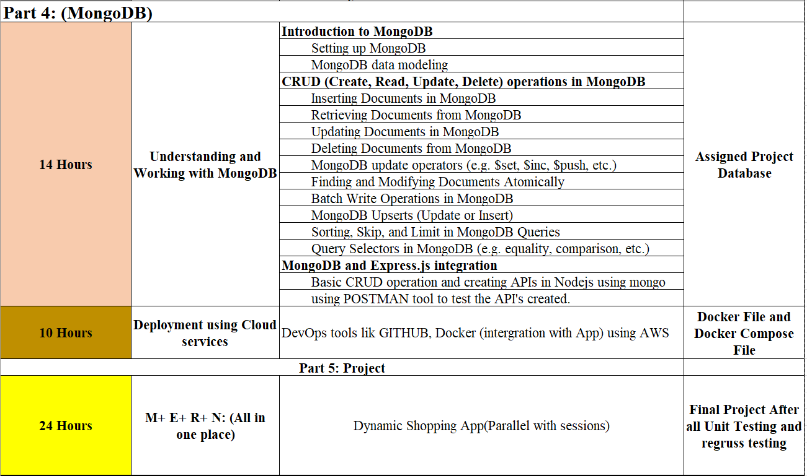
Syllabus

Slide 13
Outcomes
Upon completion of the course, students will be able to: ​
​
Understand the basics of full stack web development ​
Understand the basic of Web Application Architecture​
Develop responsive web pages using HTML and CSS ​
Implement client-side scripting using JavaScript ​
Build single page application using React JS ​
Develop RestAPI using Node JS and ExpressJS​.
Manage data using MongoDB​
Deploy web applications on NGINIX Server ​
Understand the best practices for building secure web applications ​
Develop real-world web applications using various technologies learned in the course​
Demonstrate your technical proficiency using Git Repository​

Slide 14
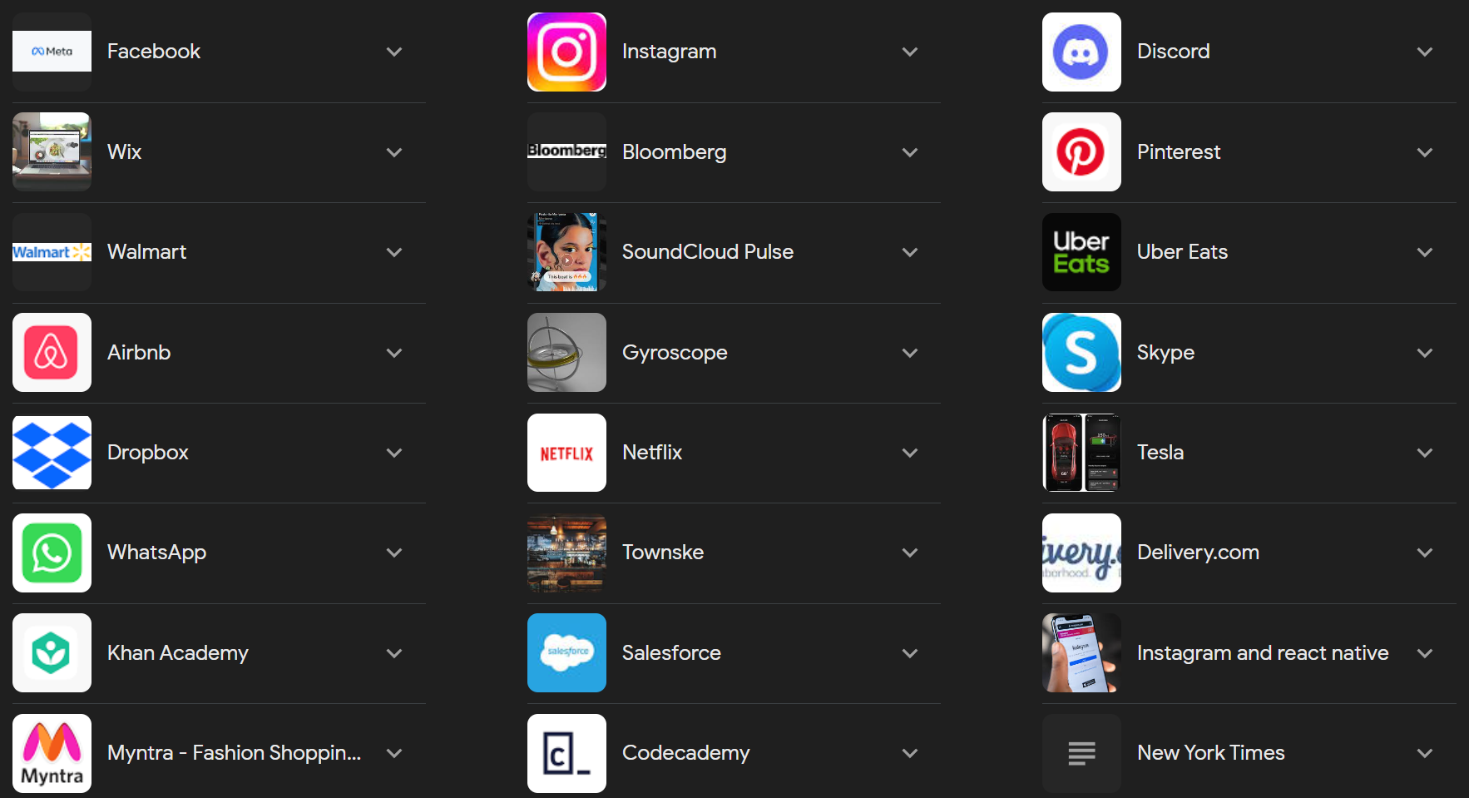
Popular apps built with React
Tempo Bootstrap Template - Index (abesconference.netlify.app)

Slide 15
Thank you

